Slide 1
Elbow River in Calgary (ERIC)
Maureen Bell

Slide 2
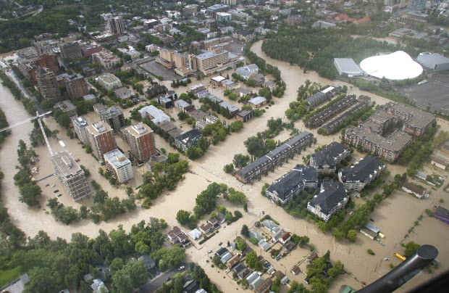

Slide 3
Requests to The City of Calgary
1. We request The City advise where any and all berms, channel blockages, sand bagging, temporary dams, or any other form of public property protection will be built, constructed, placed that will or may affect the flow of the river in our communities.
We are aware that the Safeway berm was recommended in the Expert Panel’s report notwithstanding the adverse impact on the community.
We are aware of the Stampede Flood walls and have been advised there will be no impact from the Flood walls on our neighbourhoods (no hydrological analysis complete).
We are not aware of other measures intended to protect the downtown, LRT, Saddledome, City Hall, Macleod Trail, or other private or public properties in the watershed. Any emergency or other measures you intend may cause unintended consequences to the ERIC Communities and we request advance knowledge.

Slide 4
Requests to The City of Calgary
2. When The City protects the “public good”, the impact on all or any part of all of our communities must be understood and we must be advised so we can take the appropriate action. If you consider your highest duty to be to the larger public food, you must be responsible for the impact.
3. We request The City place cranes at the bridges to remove the debris during high water.
4. We request The City remove the debris in the river now, so it will not block the river or bridges during high water.

Slide 5
Requests to The City of Calgary
5. We request The City provide its report on the condition of the Elbow River from the Reservoir to the Bow with respect to the changes in the channel. We assume the report is complete in order for The City to understand the issues that may arise from the next high water event.
We can reasonably expect changes in the path of the river which will be different in 2014 high water due to the changes in the channel. In the event such a report or analysis is not available, we ask that it be done forthwith so that we can be informed of the changes that may affect the risk to our properties.
6. We request The City dredge the Elbow River in Calgary to clear the channel where it is appropriate. We note The City has responsibility for managing the river which includes dredging so we are not adversely impacted by the channel change.

Slide 6
Requests to The City of Calgary
7. What sandbags and other equipment will be available for each of the ERIC communities? Who within The City of Calgary is our contact?
8. When will The City of Calgary ask the citizens of the ERIC neighbourhoods what they need to prepare for 2014 high water in addition to the matters set out in this request. Our next meeting is May 13, 2014 at which we can accommodate you. Our preference is to invite you to come to a meeting where several people can hear the answer to each question rather than the current open house model at which each person may ask the same question over and over of The City employees present. The model does not allow collective wisdom which is essential for community safety.
9. We confirm our communities are under considerable stress and ask that you provide support. We advise monies are budgeted for this service.

Slide 7
Requests to The City of Calgary
10. As experts you know what we need to know. We request that you share that information with us. To not share the Master Plan puts our communities, our properties, and our people at greater risk.
11. We confirm our invitation for The City of Calgary to join our next meeting on May 13, 2014.

